Slide 1


Slide 2

Trying, Failing and Trying Again
*Or When is a Petting Zoo Not a Petting Zoo?
Notes:
*Not an actual petting zoo. What do we mean by “Petting Zoo” ?

Slide 3
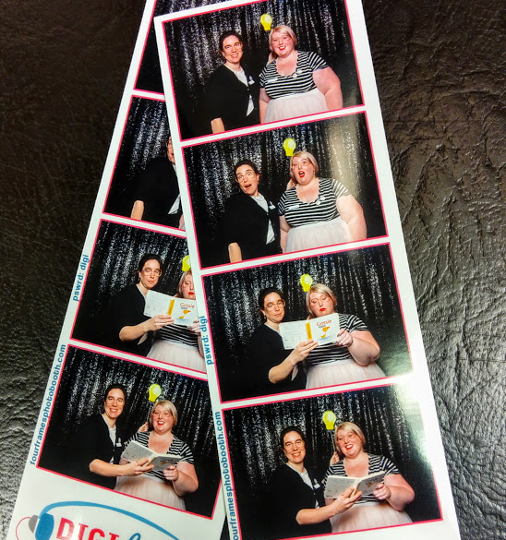
Intro
Who are we?
Why are we here?
Notes:
We are Devon Tatton and Rebecca Baugniet! You may remember us from such Library Conferences as VILSC 2017 – Teen Volunteerism, and VILSC 2018 Participatory Culture in Public Libraries
If you were at the presentation last year you may recall that someone asked us why all the fun programs were aimed at teens
We took that question seriously because it was also something our patrons had been asking for and decided to launch our welcome to the future series a participatory program series for adults using our new collection of tech equipment for DigiLab programming
That’s what we are here to talk about today!

Slide 4
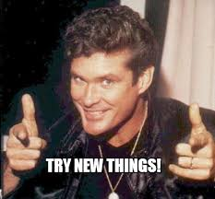
First we tried…
Took model that worked for teen demographic and applied it to our adult programs
Welcome to the Future:
VR Petting Zoo* was born
Notes:
DigiLab Background Info – Teen Lead – Works well because teens don’t want to be told what to do, they want to explore it and figure it out for themselves
So based on that success we developed Welcome to the Future: VR Petting Zoo as a mirror to our teen programs: a 1 ½ hour program for exploring some of our VR tech. We started with participants seated in a circle and asked everyone to introduce themselves and any experience (if any) they had with VR. We briefly introduced the tech we had set up: an HTC Vive with the tilt brush digital art app, some Merge Goggles and Cubes and some Google Cardboards, and then invited them to try them out. Nobody moved, so we offered to provide a demo of each station.
Sidenote about our title that took us waaay too long to realize, as you know libraries use the term Petting Zoo in a way that may not be familiar to the general public

Slide 5
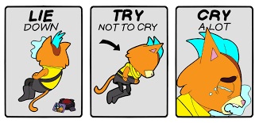
…Then we failed
Not having a real or Virtual Petting Zoo
Some of our tech failed
Structure or lack thereof
Lack of information on how it is currently being used
Safety concerns and social anxiety
Notes:
Some of these we picked up on as we were going but we also solicited feedback at the end of the program and we got an ear full!
One particular patron told us we needed to be better prepared and that our technology needed to work perfectly, she also saw our attempt to create a comfortable and conversational space for exploration as unprepared and unprofessional

Slide 6

So we tried again!
Still started with an icebreaker
Created more structure
Prepped the technology earlier
Took more time setting up expectations
Teen Volunteer
Notes:
How do we meet the needs of our patrons looking for a more structured informational program and still promote a participatory program that fosters exploration and provides a comfortable space to try something new for the first time
-got people to share their interests and background with technology
-

Slide 7


Intro to Virtual Reality
What is virtual reality?
What is the difference between VR and AR?
VR is the computer-generated simulation of images or whole environments that can be experienced using special electronic equipment.
VR immerses you in a virtual environment while AR starts with the real world and overlays virtual objects (The most well-know example is Pokemon Go).
Notes:
So now we are going to run through a few slides from that presentation to give you an idea of what it looked like, and maybe if you’re thinking about offering VR programming at your library.
At this point we also shared some info on the history of VR – we found that ALA’s Center for the Future of Libraries was a great resource here.

Slide 8
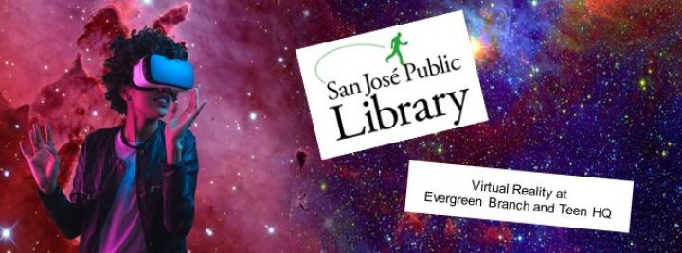
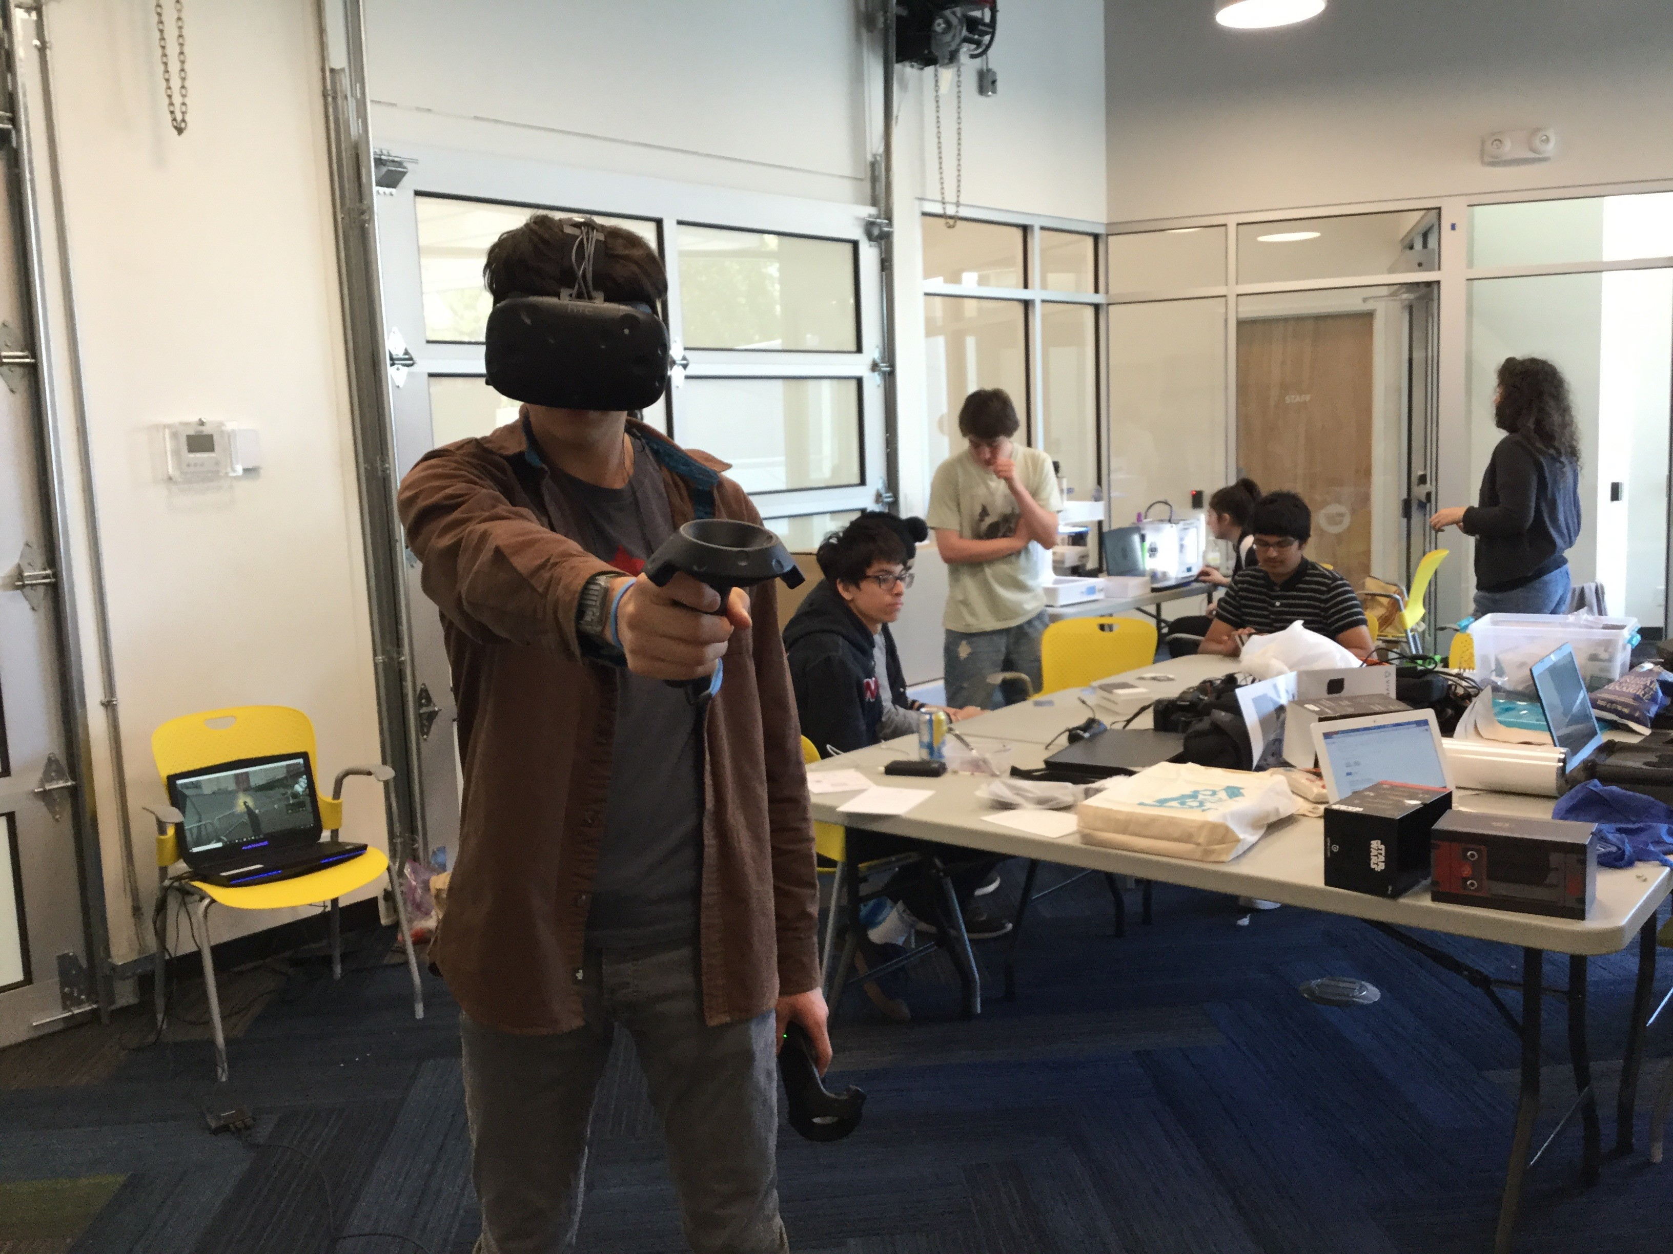
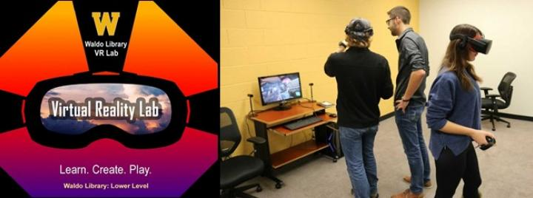
VR and Libraries
Notes:
Libraries have long served as points for the public’s first exposure to new technologies, and they are playing that role again with virtual reality. Many libraries are setting up Virtual Reality labs where patrons can experience VR, play games or visit far away places. Toronto Public Library offers VR Pictionary programs for tweens… Here at GVPL we have been using VR in our DigiLab program for teens – the photo on the left shows one example. The VR program we’ve been most excited about was when our teen advisory group collaborated with the City of Victoria’s 2018 Youth Poet Laureat, Agartu Ali, to create a VR Poetry Lounge. Last month we partnered with the Victoria Film Festival to present VR movie viewing here at the Central branch.

Slide 9
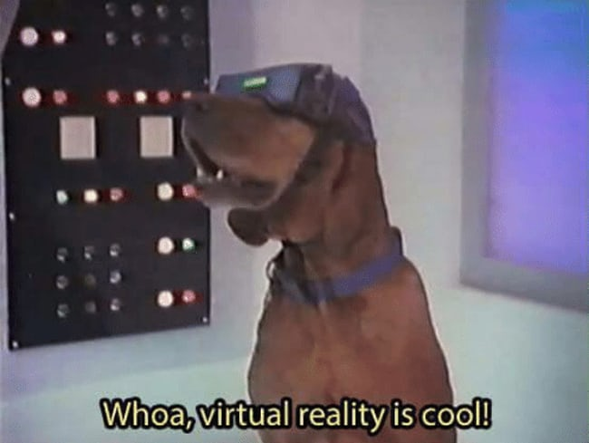
Different ways VR is being used
Guangzhou Zoo
Treatment of PTSD
Training Doctors
Retirement homes
Gaming
Art modeling
Notes:
Doctors – training, replacing expensive equipment and offering a more immersive experience and finding weaknesses in genes and viruses

Slide 10
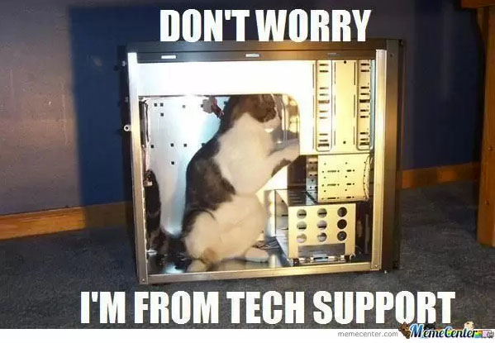
VR Hardware
Headset to cover eyes
Wires and more wires!
Handheld component
Base Stations
Cellphone, tablet, computer
Still early days – can be temperamental

Slide 11
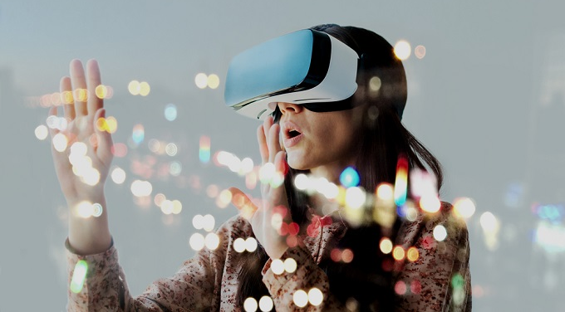
What to expect
Immersive experience
Do things you will never do in real life
Can play alone or with friends
It can be overstimulating
Best experienced with breaks

Slide 12
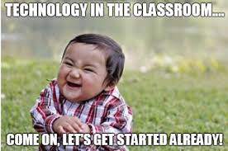
Your turn!
HTC Vive
Try out the Tilt Brush or Ritchie’s Plank Experience
Google Cardboard
Try out Urban Hike demo to
visit Paris and Rome
Merge Goggles and Cubes – Hold ancient artifacts in your hands
Coming soon:
Oculus Go!

Slide 13
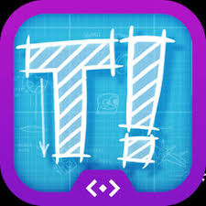



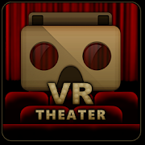
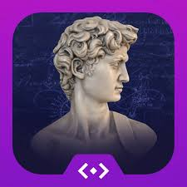
Useful apps

Slide 14

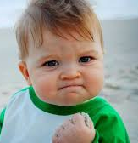
Success!
Positive Feedback in the program and via email
Sense of enjoyment and a more positive feeling from participants
We continue to learn and adapt our programming
If at first you don’t succeed try and try again!
Notes:
Often with programming if something doesn’t work we move on to a different idea or program
- Different participants with different needs: someone looking to buy VR as a gift, teacher wanting to bring the tech to the classroom and seniors who were curious
Use the teens in your community as inspiration

Slide 15
Questions?

